Slide 1

By Swapna Macha
Global Health Trends Analysis

Slide 2
Contents
Project Brief
Dataset Overview
Problems or challenges in the Dataset
Data Cleaning and Transformation Process
Insights and Findings
Recommendations

Slide 3
Project Brief
The Global Health project utilizes Tableau to analyze global health data.
Focuses on key metrics, including life expectancy, BMI, population growth, and cancer rates.
Aims to uncover disparities and trends across regions and demographics.
Supports data-driven decision-making for targeted healthcare interventions and resource allocation.

Slide 4
Dataset Overview
The dataset contains health-related metrics for various countries, including:
Life Expectancy: Average lifespan for men and women.
BMI: Average body mass index segmented by gender.
Population Growth: Annual growth rates by country and continent.
Cancer Rates: Incidence of different cancer types. This comprehensive dataset serves as a foundation for analyzing global health trends and their implications.

Slide 5
Problems or Challenges in the Dataset
Data Quality Issues: Missing or incomplete records in metrics like BMI and cancer rates.
Outliers: Extreme values in population growth and life expectancy needed handling.
Format Standardization: Inconsistent formats for numerical fields required preprocessing.
Data Volume: High dimensionality needed aggregation for effective visualization.

Slide 6
Data Cleaning Transformation Process
Removed duplicates and handled missing values using averages or exclusions.
Standardized numerical and categorical fields for consistency.
Created calculated fields for metrics like BMI categories and population growth rates.
Aggregated data by region and gender for simplified visualization.

Slide 7
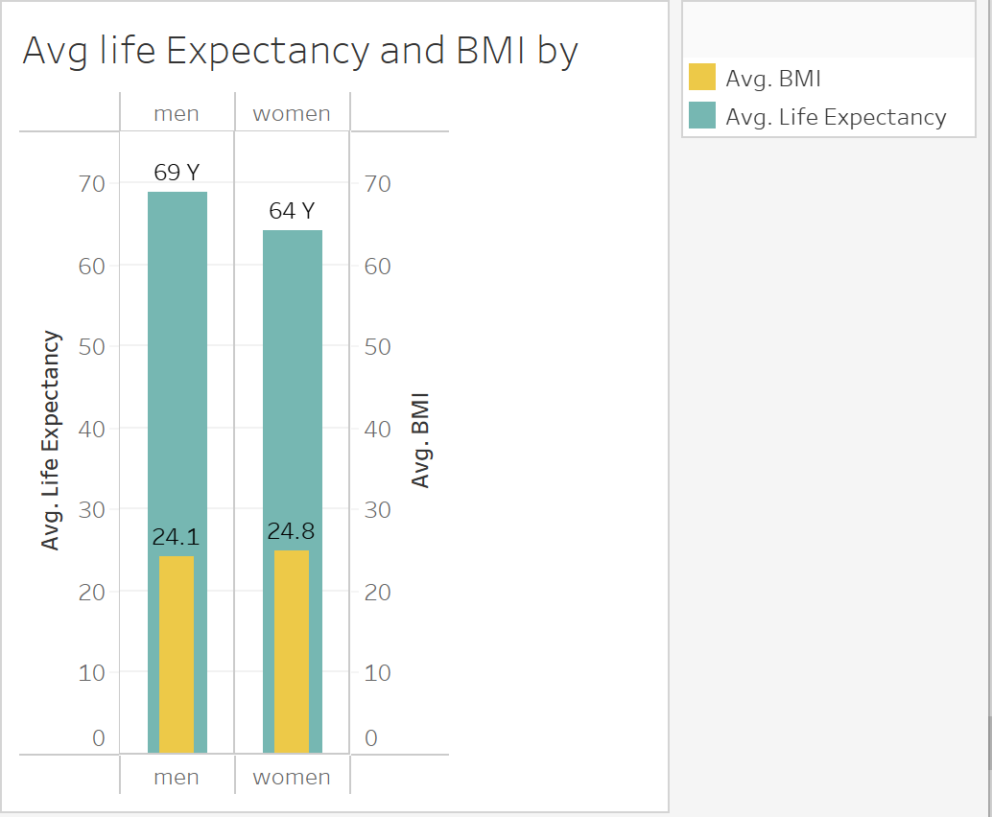
Men have a higher life expectancy (69 years) than women (64 years).
Women have a slightly higher BMI (24.8) compared to men (24.1).

Slide 8
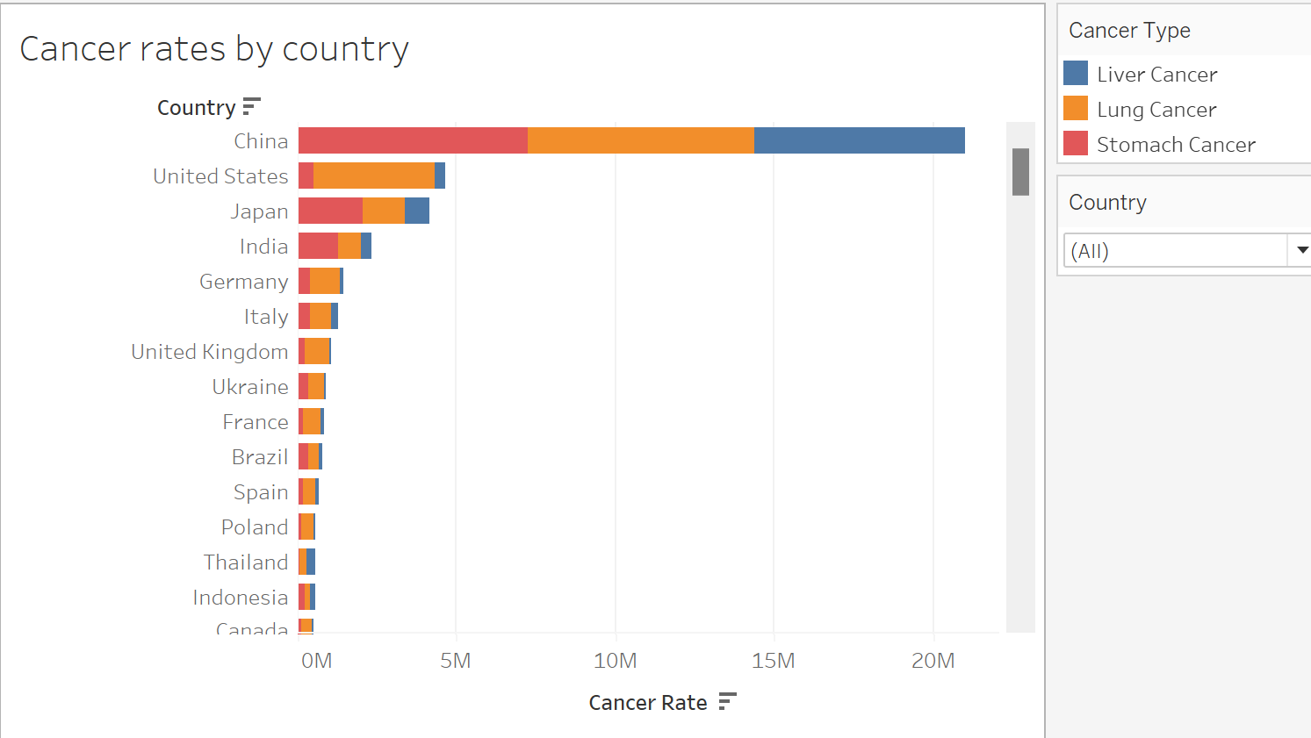
China leads with the highest cancer rates, dominated by liver cancer.
The United States and Japan follow with significant lung and stomach cancer cases.
India shows high stomach cancer prevalence.
Higher cancer rates are seen in developed nations due to better diagnostics and aging populations.

Slide 9
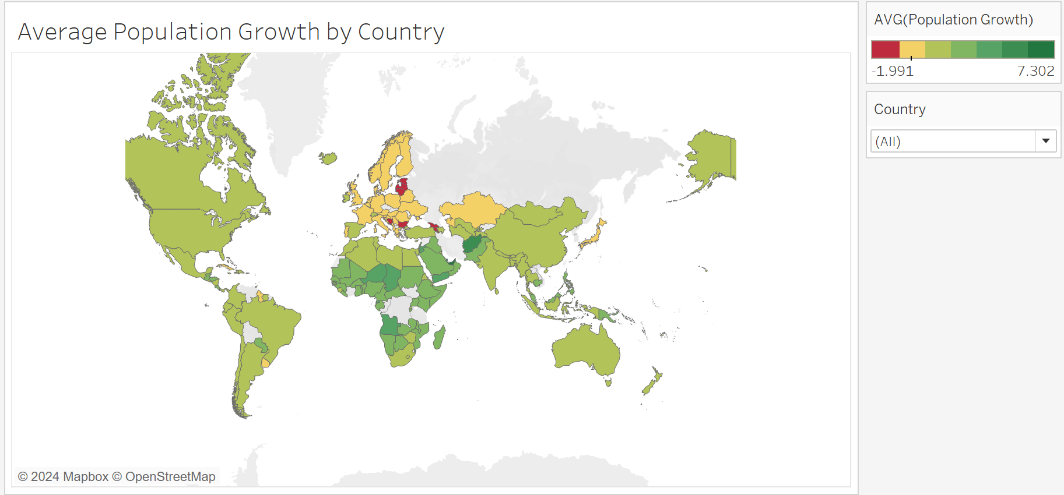
African countries show the highest average population growth rates.
Europe has low or even negative population growth in some regions.
Countries in South Asia and South America exhibit moderate population growth.

Slide 10
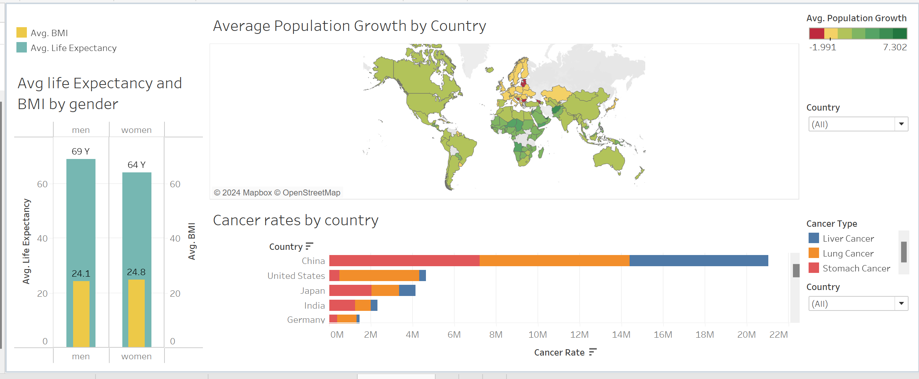

Slide 11
Recommendations
Focus on High-Cancer-Rate Regions:
Allocate healthcare resources to countries like China to address high cancer incidence.
Promote Healthy Lifestyles:
Encourage balanced diets and physical activity in regions with high BMI levels.
Support Low-Life-Expectancy Regions:
Invest in healthcare infrastructure in areas with below-average life expectancy.
Target Rapid Population Growth Areas:
Develop sustainable healthcare solutions for rapidly growing populations in Africa and Asia.

Slide 12
Thank You

